Slide 1

Advanced x86: BIOS and System Management Mode Internals Chipset Architecture
Xeno Kovah && Corey Kallenberg
LegbaCore, LLC

Slide 2
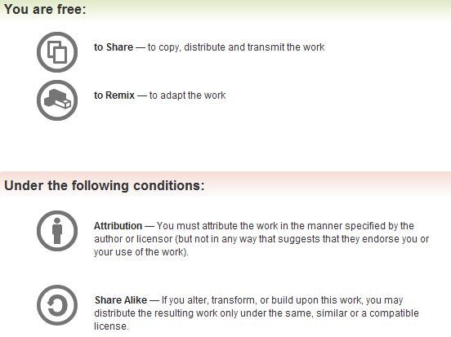
All materials are licensed under a Creative Commons “Share Alike” license.
http://creativecommons.org/licenses/by-sa/3.0/
Attribution condition: You must indicate that derivative work
"Is derived from John Butterworth & Xeno Kovah’s ’Advanced Intel x86: BIOS and SMM’ class posted at http://opensecuritytraining.info/IntroBIOS.html”
Notes:
Attribution condition: You must indicate that derivative work
"Is derived from John Butterworth & Xeno Kovah’s ’Advanced Intel x86: BIOS and SMM’ class posted at http://opensecuritytraining.info/IntroBIOS.html”

Slide 3
(Basic) Chipset Architecture
Since I always lose the link, CPU datasheets are here:
http://www.intel.com/content/www/us/en/processors/core/core-technical-resources.html

Slide 4
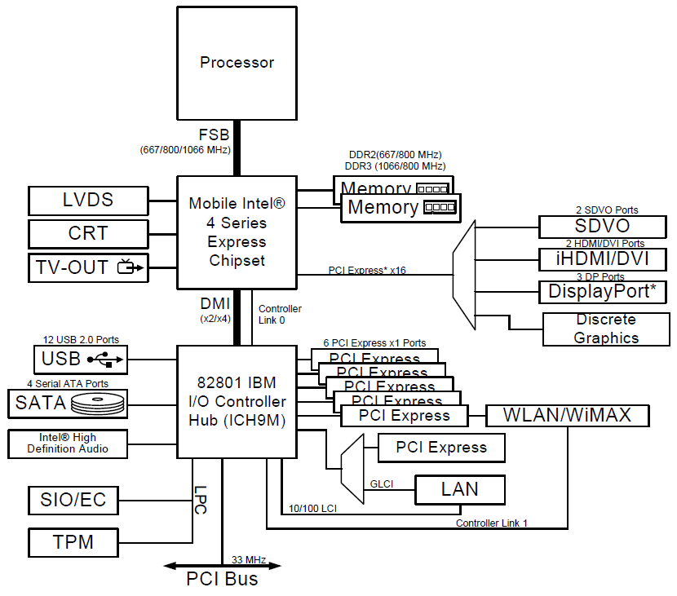
Mobile 4-Series Chipset Block Diagram
This is a hardware model the Mobile 4-Series chipset and its logical relation to the CPU
Specialized chips integrated onto the motherboard that interface the processor to system components.
Two components make up the chipset: the Memory Controller Hub (MCH) and the I/O Controller Hub (ICH)
These components must be configured to be able to sustain an Operating System.
BIOS performs this configuration during boot
I prefer the diagram from the Desktop 4-Series Chipset, which explicitly labels the MCH
Intel Mobile 4-Series Chipset Datasheet, pg. 13
Notes:
A fair number of these pertain to security and that’s what we’ll focus on.

Slide 5
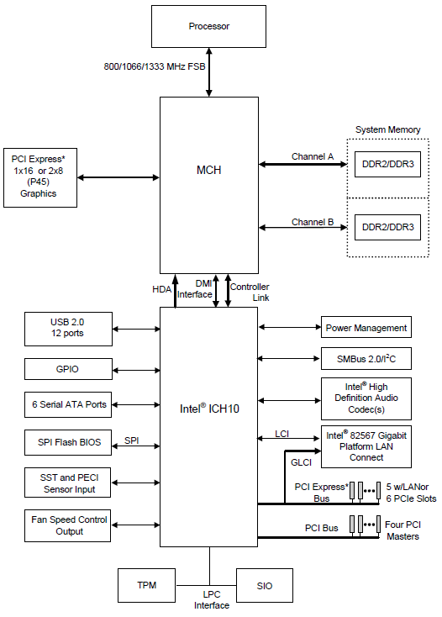
Alternative Block Diagram
For reference, this is the diagram layout I personally (strongly) prefer
But it explicitly labels the MCH
Also lists the SPI device, unlike it’s Mobile counterpart
However, the MCH on the 4-Series chipset connects to an ICH rev.10 rather than an ICH rev. 9, which is not what's present on this example E6400 system
Intel 4-Series Chipset Datasheet, pg. 25
Notes:
They are probably similar enough to reference this one instead, but I will not do that.

Slide 6
Mobile 4-Series Chipset Block Diagram
Memory Controller Hub (MCH)
Interfaces the processor with the rest of the system
Connected via a fast bridge/bus (originally FSB, became HyperTransport (AMD) and QuickPath (Intel), the latter which became DMI (or DMI 2.0)
From a logical perspective it’s invisible to us for our purposes
Sometimes called the Northbridge
Contains a Memory Controller and an interface for PCI Express graphics
A ‘G’ in front of MCH indicates it has on-board graphics
Intel Mobile 4-Series Chipset Datasheet

Slide 7
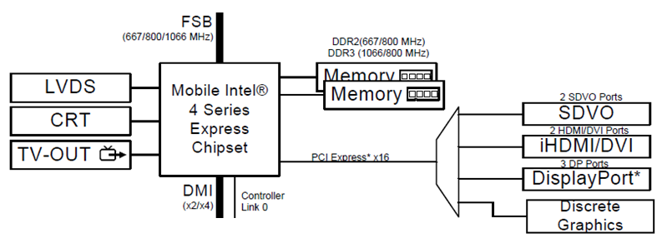
Memory Controller Hub (MCH)
For this course on BIOS/UEFI security, the aspects of the MCH (or Platform Controller Hub (PCH) as it has evolved to) we care about most are:
Chipset Configuration registers
DRAM Controller Registers
In PCH systems the DRAM Controller Registers move into the CPU (we will talk about this in a bit)
Intel Mobile 4-Series Chipset Datasheet, pg. 13
Notes:
There are still a lot of systems out there that pre-date the consolidation into the CPU.

Slide 8
I/O Controller Hub
Interfaces the MCH (and thus the processor) to system devices
Intel Mobile 4-Series Chipset Datasheet

Slide 9
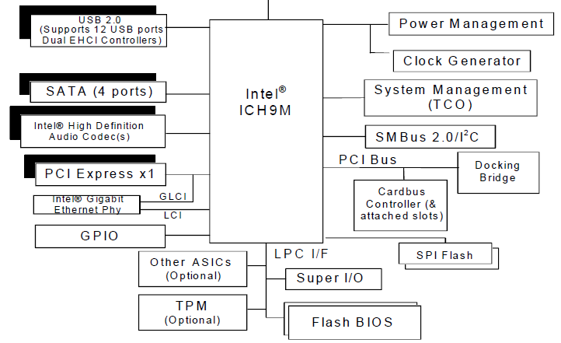
Serial-Peripheral Interface (SPI)
(This is the Firmware Hub (FWH). We’ll cover this briefly when we talk about SPI.)
It’s where the BIOS binary resides
CPU execution starts here upon system startup
Interface to the device is Memory-Mapped
We’ll cover memory-mapping in the Address Space portion of the course
From a software development, configuration is still the same when the ICH is consolidated into a PCH
Intel I/O Controller Hub 9 Datasheet, because it includes a more complete block diagram
Notes:
These hold true whether the system is an older MCH/ICH system or a new consolidated PCH system

Slide 10
Low-Pin Count (LPC)
The devices on the ICH which we care about most are:
LPC (Low-Pin Count) controller device
Firmware Hub (legacy)
Trusted Platform Module (TPM)
Notes:
These hold true whether the system is an older MCH/ICH system or a new consolidated PCH system

Slide 11
Trusted Platform Module (TPM)
Extends the security functions within the TPM chip to the CPU/system
Memory-Mapped (fixed address)
Software operation is still the same when the ICH is consolidated into a PCH
Intel I/O Controller Hub 9 Datasheet, because it includes a more complete block diagram
Notes:
These hold true whether the system is an older MCH/ICH system or a new consolidated PCH system

Slide 12
Evolution to Platform Controller Hub (PCH)
Bottleneck reduction
Memory Controller moved into the CPU
AMD did this in ~2003 with Athlon64
Intel ~2008 (Core i-series CPU)
Graphics processing unit too
The Northbridge was essentially eliminated to form a single component (PCH)
Overall trend is to move high-bottleneck areas closer to the CPU which has the fastest clock on the system
Intel 4-Series Chipset Datasheet

Slide 13
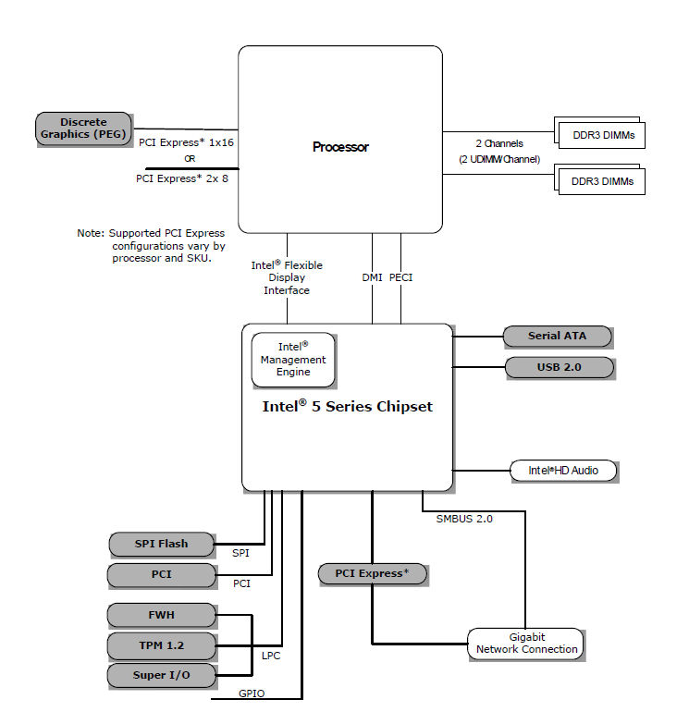
Now everything’s just PCHy
Shown here is the Intel 5-series chipset
First iteration of the consolidation into a single Platform Controller Hub (PCH)
AMD did similar in 2003, but I don’t want to throw too many hardware diagrams at you (despite being different at the hardware level, logically they are similar if not the same)
Better to show you just a few, explain why they are the way they are so then you can interpret new/different ones yourself
Processor is starting to resemble a System On a Chip (SoC)
(PCH)
Intel Core i5-600, i3-500 Desktop Processor Series, Intel Pentium Desktop Processor 6000 Series datasheet
Notes:
No more diagrams like the previous, no good block diagram of a PCH
The Chipset no longer consists of 2 components but of a single component, PCH

Slide 14
Platform Controller Hub (PCH)
(PCH)
All the ICH components that we cared about for this course are still present
From a software standpoint, even their mode of access is the same
Functionally speaking, most of what we’ll be looking at is agnostic as to whether its MCH/ICH or PCH
There are a few exceptions and those will be addressed as they crop up as well as how you account for them
Intel Core i5-600, i3-500 Desktop Processor Series, Intel Pentium Desktop Processor 6000 Series datasheet
Notes:
No more diagrams like the previous, no good block diagram of a PCH
The Chipset no longer consists of 2 components but of a single component, PCH

Slide 15
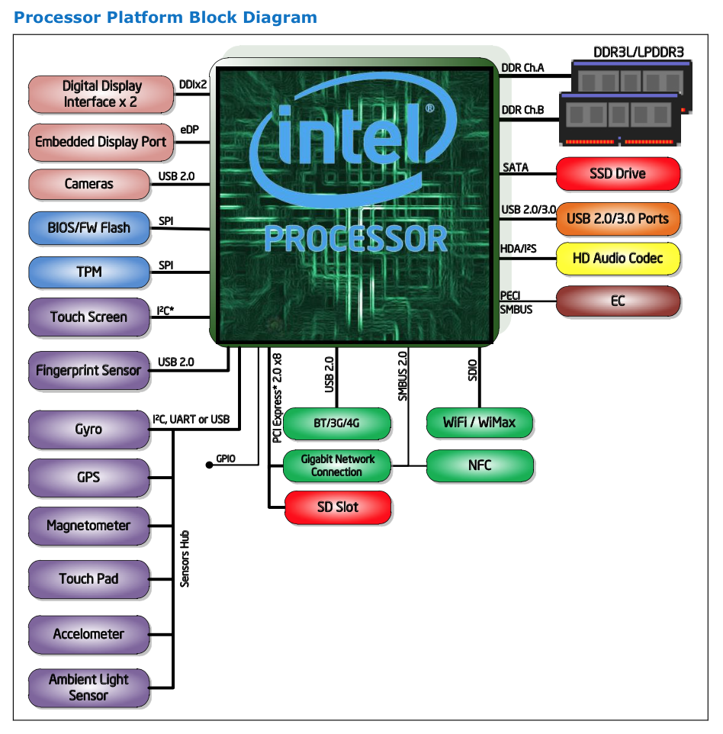
Aside: Yeah it’s really getting SoCish: Haswell/Broadwell mobile

Slide 16
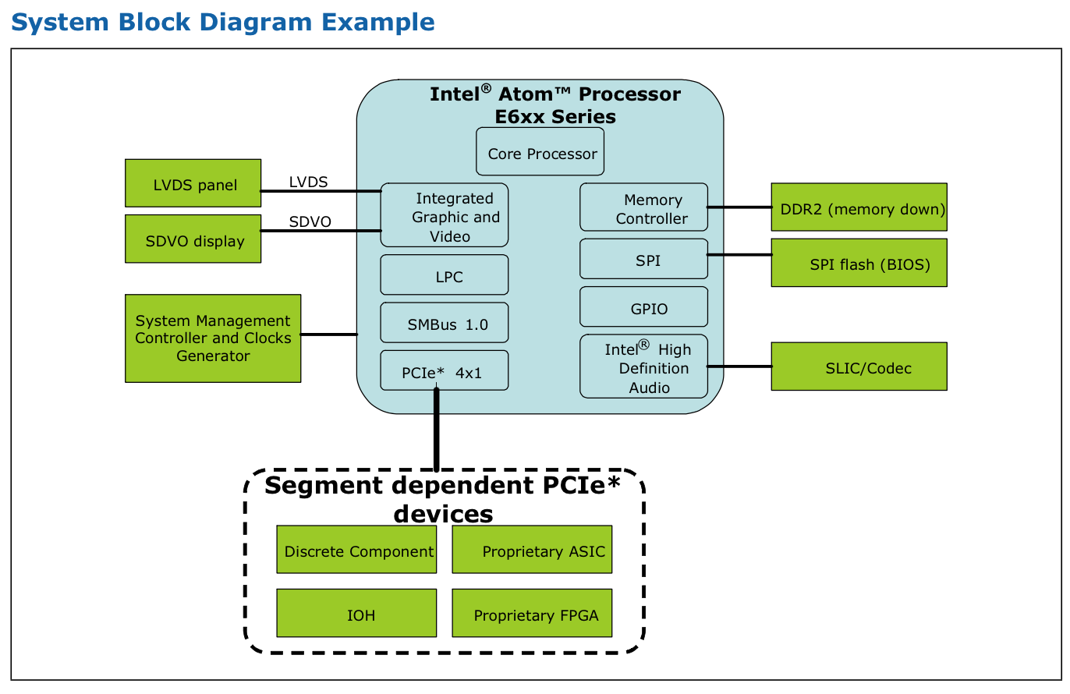
Aside: Intel does make some SoCs, their “Atom” series. Out of scope for today
From Intel® AtomTM Processor E6xx Series Datasheet

Slide 17
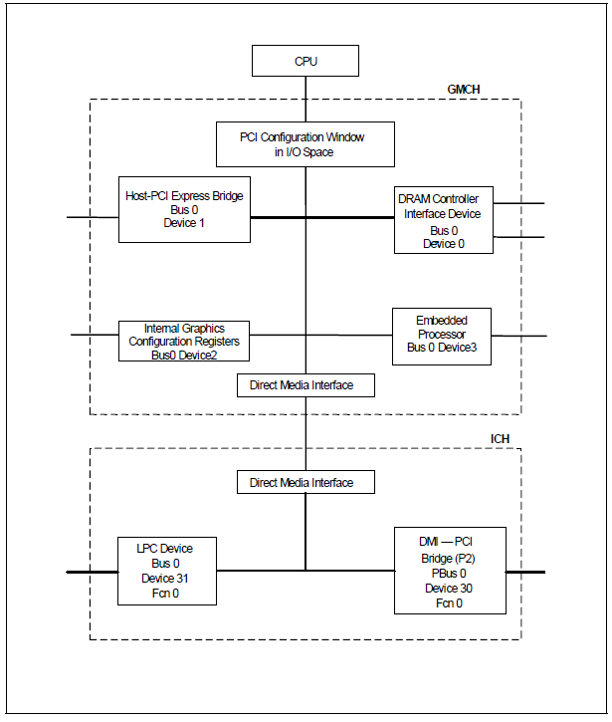
Software Model
This is how the processor sees the chipset devices
Not actually a complete diagram, there are more devices listed in the datasheet than what Intel included in this diagram
Some devices have additional functions (it’s a PCI-thing which we’ll talk about)
* Device 2 won’t be implemented if there is an external graphics card.
Notes:
How your CPU sees the hardware

Slide 18
Device 0: DRAM Controller
Device 0 – DRAM Controller
Configured by BIOS to define much of the memory map
SMM
PCI Express base address register space(PCIEXBAR)
Etc.
Notes:
How your CPU sees the hardware

Slide 19
Device 31: LPC Interface Bridge
Device 31 – Low Pin Count Interface (LPC) Bridge
Located on ICH (or PCH if it’s a PCH system)
Implements various system management functions
We reference this device a lot
Spec: http://www.intel.com/design/chipsets/industry/25128901.pdf (Low Pin Count Interface Specification, Revision 1.1)
Notes:
How your CPU sees the hardware

Slide 20
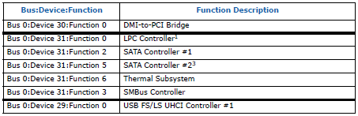
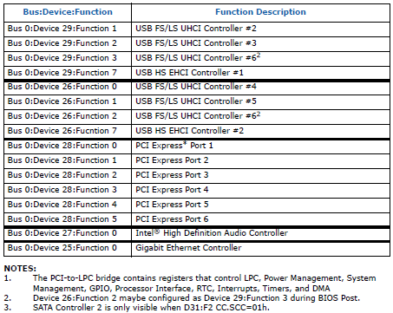
Datasheet will list all PCI Devices
So as I said, there are devices which were not included in the chipset diagram provided by Intel in the Mobile 4-Series datasheet.
They’re not all important from a security perspective, but provided here for reference
*Intel I/O Controller Hub 9 datasheet

Slide 21
Chipset Identification
Goal: Identify the Chipset and/or Controller Hub
Reasons: (1) To find the datasheet, and (2) know the locations of those registers which we will be probing to determine whether a system is vulnerable
Some have stayed the same (same name, same offset) over the years (LPC, BIOS_CNTL) while others have “bounced around a little”
Our demonstrations/slides are all on the Mobile 4-Series Chipset and IO Controller Hub Family 9
However, the functionality provided by these registers still exist in the latest architecture (assuming they aren’t just still the “same old registers”)
We want you to be able to locate/analyze these (ie: teaching you to fish)
Ok I’m convinced! So how do we find out?
We are “pretending” that we don’t have eyes on the platform itself:
In other words, we are using RW-Everything in this example, but RW-E accesses the PCI configuration space which we also could do programmatically
Notes:
Sort of like a lab

Slide 22
Strategy:
Many of the registers we care about are located in two separate devices: (1) LPC Device, and (2) DRAM-Controller
In legacy Chipsets the LPC device is located in the IO Controller Hub and the DRAM-Controller is located in the Memory Controller Hub
The datasheet containing the information related to the DRAM controller will be found in the Chipset datasheet
The datasheet containing the LPC-related information will be found in the “I/O Controller Hub” datasheet
DRAM Controller
Chipset
Datasheet
LPC Device
ICH
Datasheet
Notes:
Sort of like a lab

Slide 23
Strategy:
Many of the registers we care about are located in two separate devices: (1) LPC Device, and (2) DRAM-Controller
In Modern "Chipsets" (PCH) the LPC device is located in the Platform Controller Hub and the DRAM-Controller is located in the Processor
The datasheet containing the information related to the DRAM controller will be found in the processor datasheet
The datasheet containing the LPC-related information will be found in the Chipset datasheet
DRAM Controller
CPU
Datasheet
LPC Device
"Chipset"
Datasheet
Notes:
Sort of like a lab

Slide 24
Strategy:
If your PCI LCP device ID lookup says something like “Wildcat Point-LP”, that means you’re using a Broadwell/5th generation chip
The DRAM controller / Host Device ID will still be in the CPU specification update
The LCP device ID can be found in the CPU’s associated “IO datasheet”
Notes:
Sort of like a lab

Slide 25
Strategy: Additional Notes
You do not have to know in advance whether the architecture is a modern chipset or otherwise, the process of identifying the device ID’s will tell you that
Because we’re identifying PCI devices, this same strategy will work on an AMD system (which is completely left out in this course)
However, identifying the applicable registers and offsets is an exercise left to you (or me if I get my hands on an enterprise system with an AMD processor)
Notes:
Sort of like a lab

Slide 26
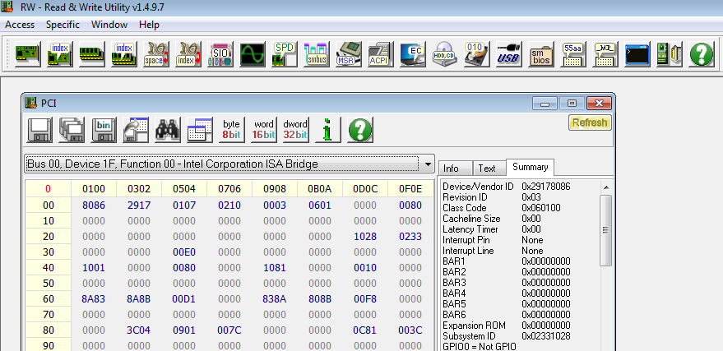
Get the LPC Device ID
Will tell us the Controller Hub family (therefore either ICH datasheet if legacy or chipset datasheet otherwise)
Bus 0, Device 31 (1Fh), Function 0, Offset 2 (2-bytes)
Not sure where RW Everything gets the names of its PCI devices from
In this example, the LPC Device ID is 0x2917
Notes:
Sort of like a lab

Slide 27
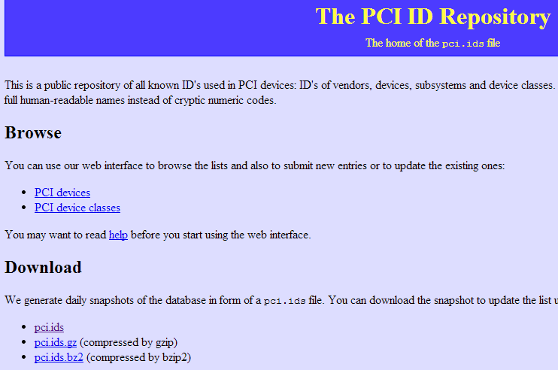
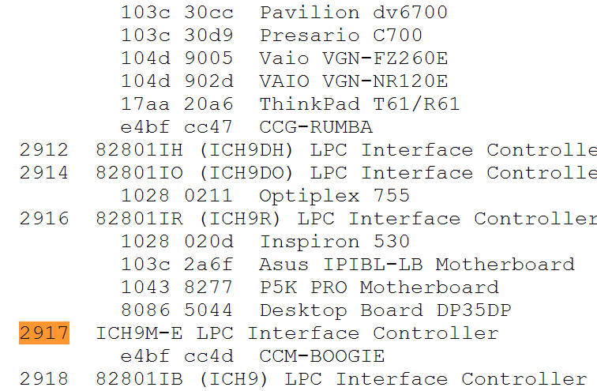
Device ID Lookup
http://pciids.sourceforge.net
http://pci-ids.ucw.cz/ (same site, alternate location)
Device ID 0x2917 is part of the ICH9M-E family
http://www.intel.com/content/www/us/en/io/io-controller-hub-9-datasheet.html
Notes:
Sort of like a lab

Slide 28
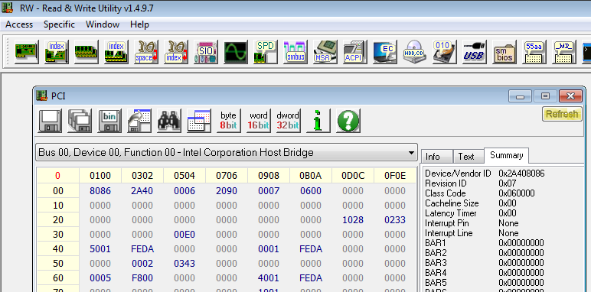
Get the Memory Controller Device ID
Read the 2-byte Device ID of the Memory Controller:
Bus 0, Device 0, Function 0, Offset 2
In this case RW Everything calls it a Host bridge, but as you can see at offset 0x0E in it’s header, it is not a bridge
PCI-related fact which we’ll cover in PCI
In this sample case the Memory Controller Device ID is 0x2A40
Notes:
Sort of like a lab

Slide 29
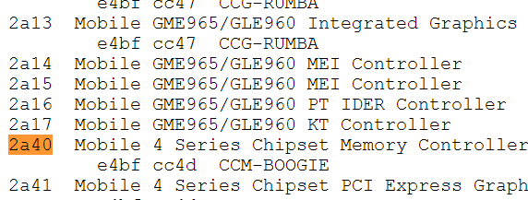
Device ID Lookup
http://pciids.sourceforge.net
http://pci-ids.ucw.cz/ (same site, alternate location)
Device ID 0x2a40 is part of the Mobile 4-Series chipset family
http://www.intel.com/assets/PDF/datasheet/320122.pdf
Notes:
Sort of like a lab

Slide 30
So what we have learned about this E6400
The LPC Device ID is 2917h
ICH9M-E Controller Hub
Member of the IO Controller Hub 9 family
The Memory Controller Device ID is 2A40h
Mobile 4-Series Chipset Memory Controller
Therefore this is a legacy chipset
DRAM controller is located in the chipset
LPC is located in the IO Controller Hub
The same steps will work on a new system
The DRAM controller will be located on the processor
The LPC device will be located in the chipset (aka: platform controller hub)
Sometimes there may be ambiguity. A discussion of how to resolve some forms of ambiguity was moved to the backup slides for this slide deck for time reasons.

Slide 31
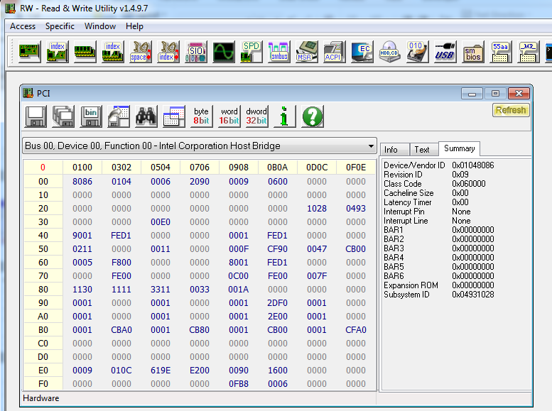
Beware: Gotcha #1
Verify the Device ID you look up is for the correct vendor
Different Vendors can use the same Device IDs
Vendor ID’s are allocated by the PCI SIG and are always unique
The above Memory Controller Device ID of 0104h returns multiple hits on http://pci-ids.ucw.cz
But it’s the 8086h (Intel) one that we want

Slide 32
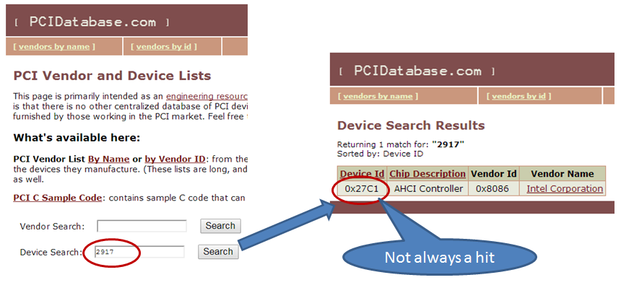
Beware: Gotcha #2
It’s good to cross-reference more than one source...
Where one fails (either returns an incorrect device, or finds no device at all), another may succeed
www.PCIDatabase.com

Slide 33
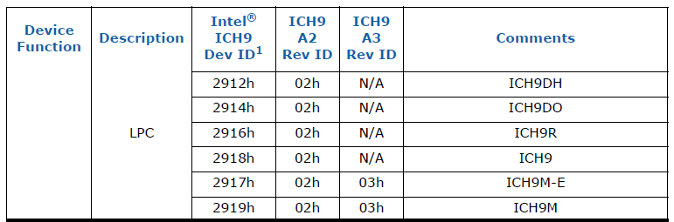
Specification Updates
For an Intel system, a given device family (Processor, IO Controller Hub, Chipset) will have a separate datasheet entitled “Specification Update”
The spec update provides typo-fixes and such but also provides the device ID’s for each revision within that particular device family
ICH Family 9 Specification Update

Slide 34
In Summary
DRAM Controller / Host Bridge PCI “Device IDs” can be found in MCH or CPU datasheets
This device will be used to find SPI flash programming registers
LPC Controller PCI “Device IDs” can be found in the ICH, PCH, or CPU’s “IO” “specification update” datasheets
This device will be used to find SPI flash access control registers
These two device IDs together provide all the information we need for identification of hardware for BIOS security checks

Slide 35
Device IDs
I’m starting to get tired of spending the time it takes to have everyone look this up, so I’ve started to make a cheat sheet ;)

Slide 36
DRAM Controller/Host Bridge
Cheat sheet

Slide 37
MCH/3-series-chipset-family-datasheet.pdf

Slide 38
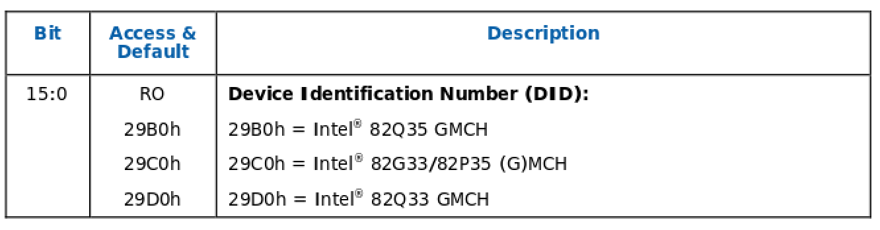
MCH/3-series-express-chipset-family-datasheet.pdf

Slide 39
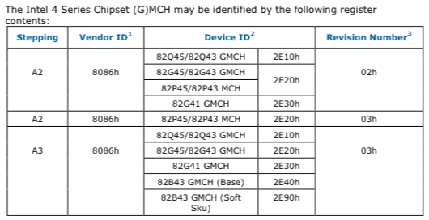
MCH/4-series-chipset-family-datasheet.pdf

Slide 40
MCH/4-series-express-chipset-family-datasheet.pdf

Slide 41
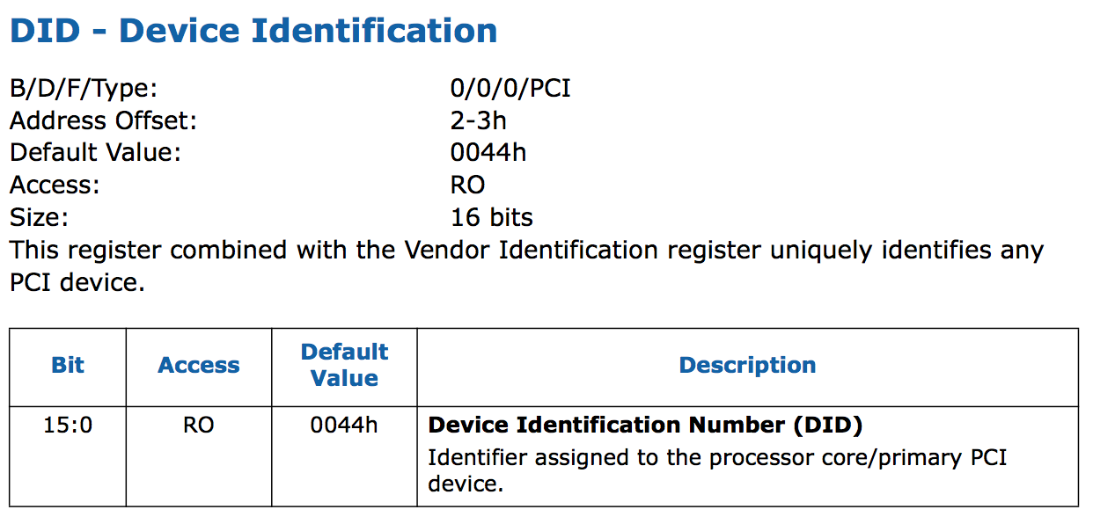
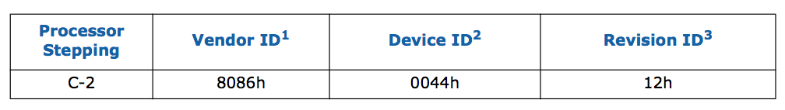
CPU/1stGen(Nehalem)/Mobile/core-mobile-datasheet-vol-2.pdf
CPU/1stGen(Nehalem)/Mobile/core-mobile-spec-update.pdf

Slide 42
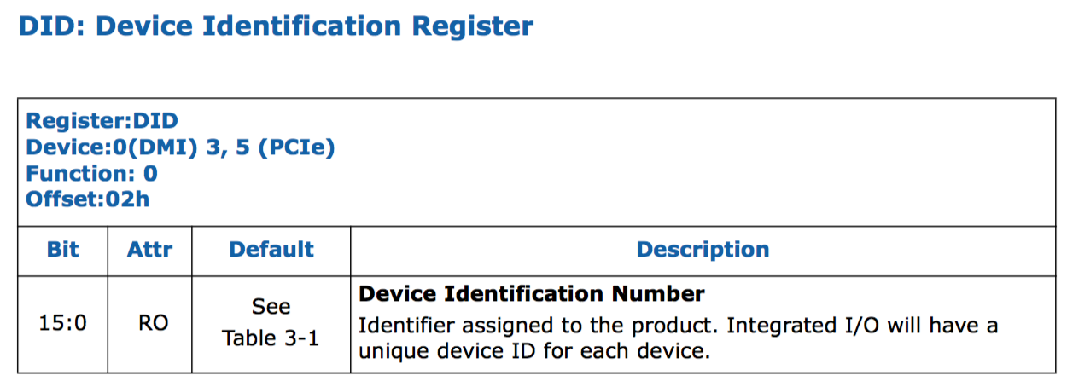
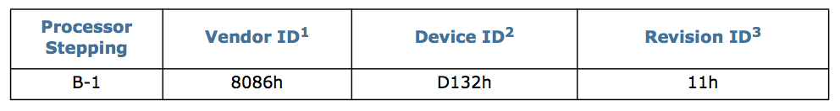
CPU/2ndGen(SandyBridge)/Mobile/2nd-gen-core-family-mobile-vol-2-datasheet.pdf
CPU/2ndGen(SandyBridge)/Mobile/core-i7-900-mobile-ee-and-mobile-processor-series-spec-update.pdf

Slide 43
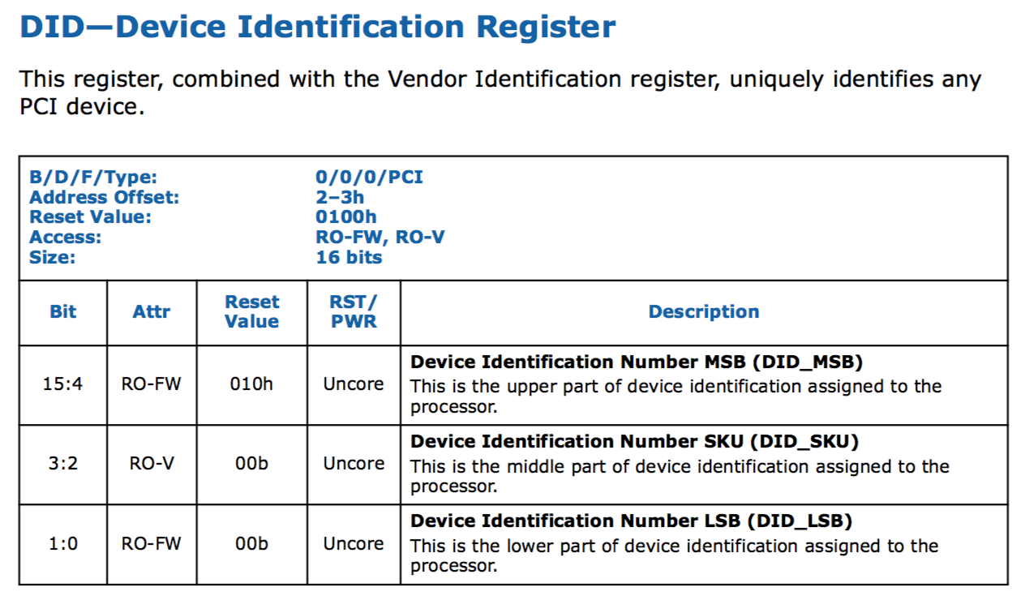
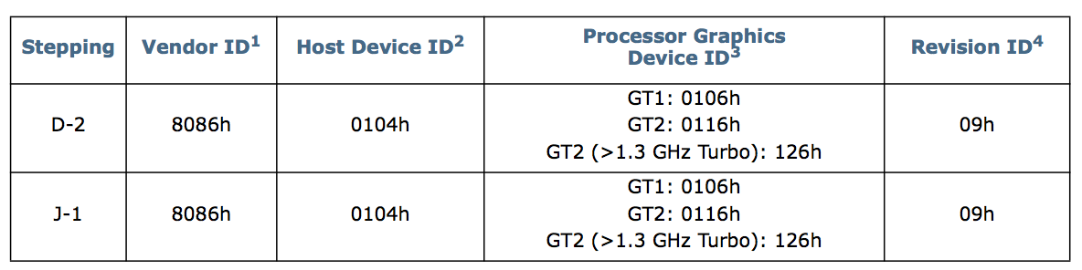
CPU/2ndGen(SandyBridge)/Mobile/2nd-gen-core-family-mobile-vol-2-datasheet.pdf
CPU/2ndGen(SandyBridge)/Mobile/2nd-gen-core-family-mobile-specification-update.pdf

Slide 44
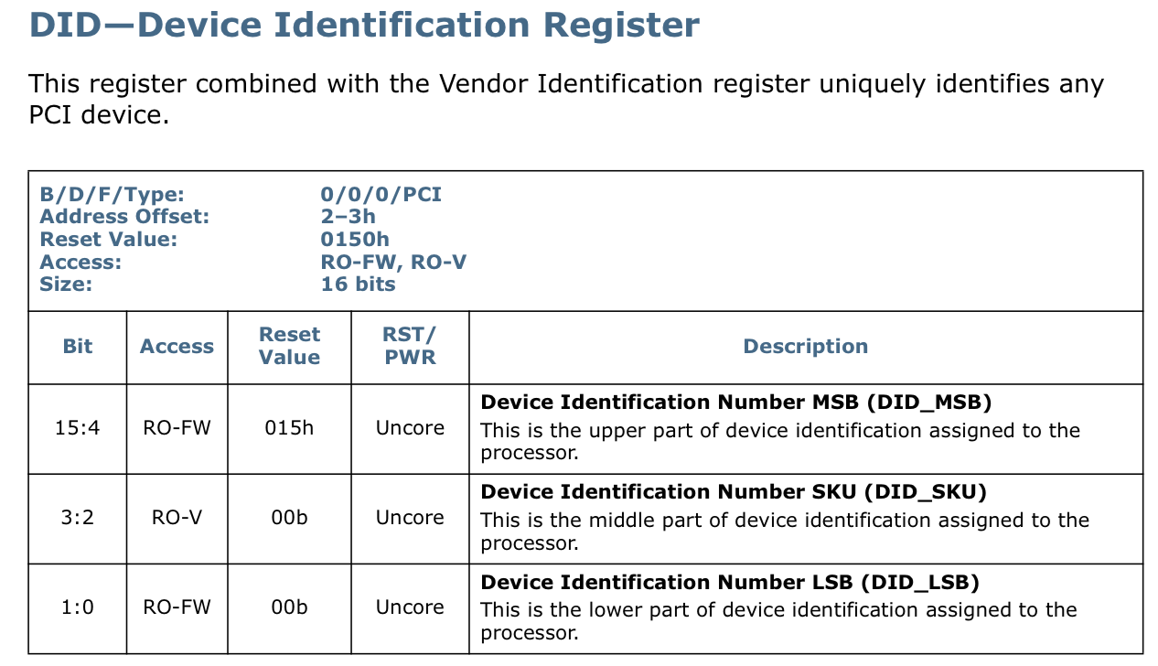
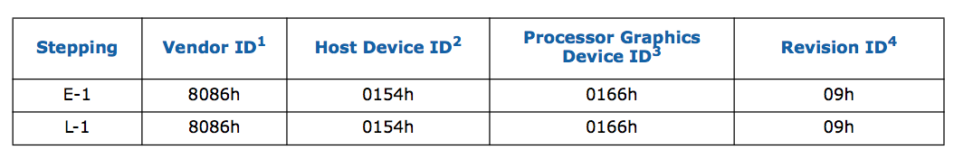
CPU/3rdGen(IvyBridge)/Mobile/3rd-gen-core-family-mobile-vol-2-datasheet.pdf
CPU/3rdGen(IvyBridge)/Mobile/3rd-gen-core-family-mobile-specification-update.pdf

Slide 45
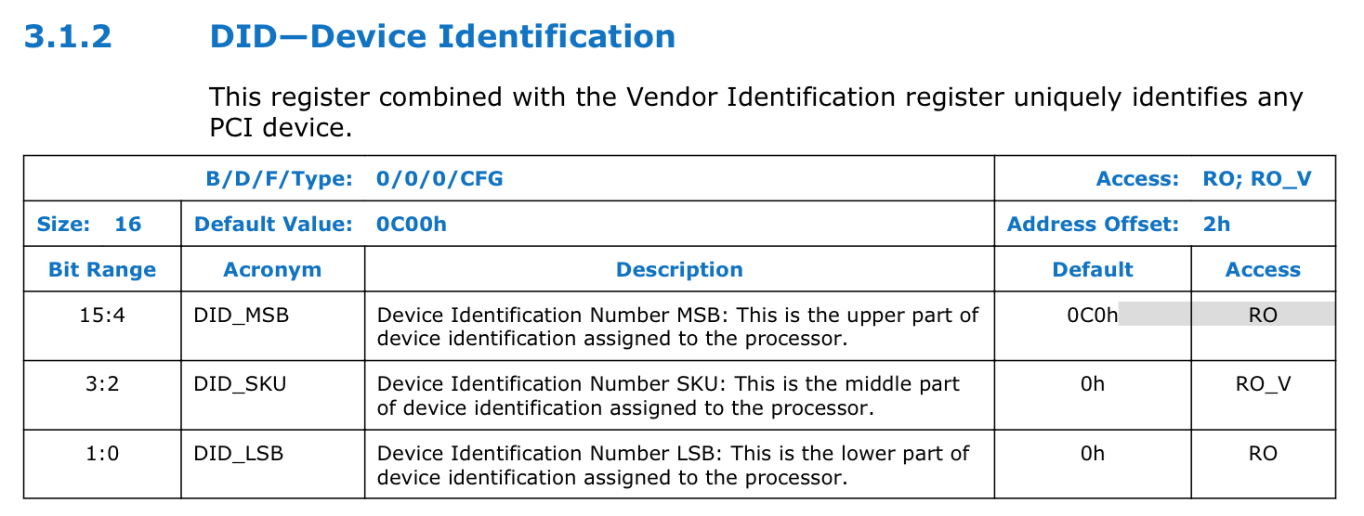
4th-gen-core-family-mobile-m-h-processor-lines-vol-2-datasheet.pdf

Slide 46
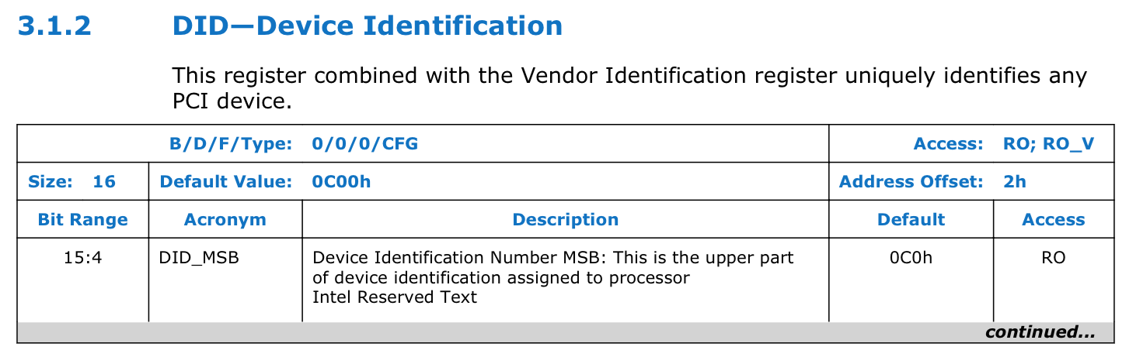
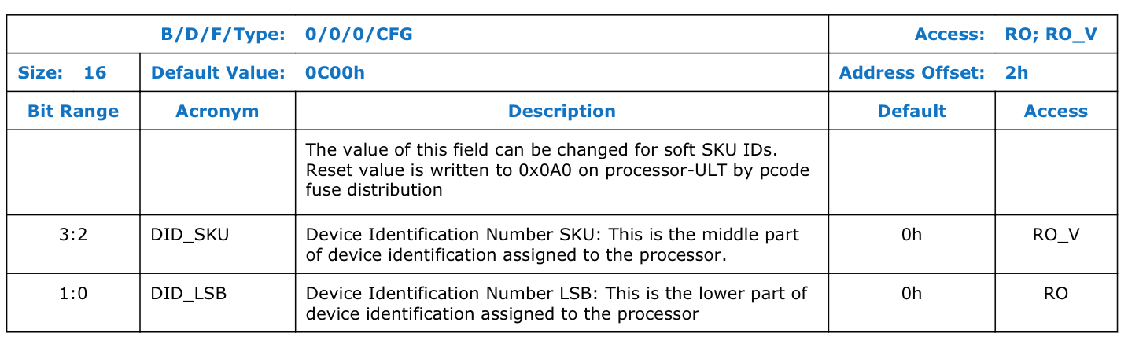
CPU/4thGen(Haswell)/Mobile/4th-gen-core-family-mobile-u-y-processor-lines-vol-2-datasheet.pdf

Slide 47
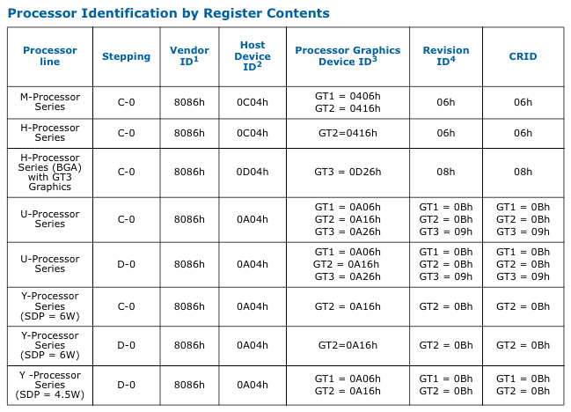
CPU/4thGen(Haswell)/Mobile/4th-gen-core-family-mobile-specification-update.pdf

Slide 48
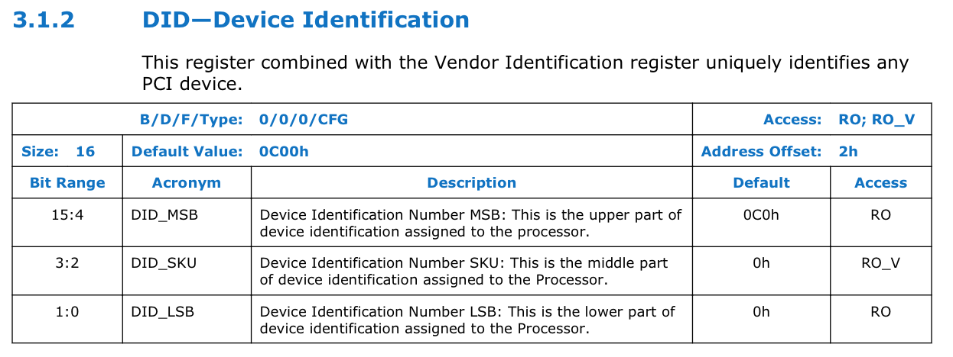
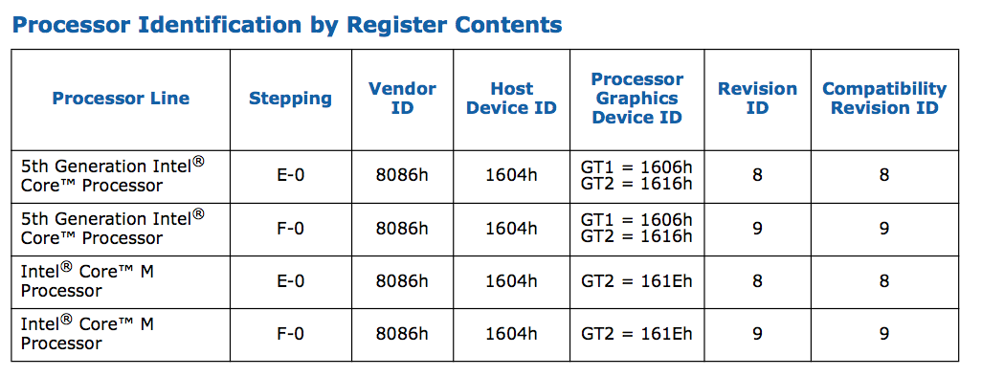
CPU/5thGen(Broadwell)/5th-gen-core-family-datasheet-vol-2.pdf
CPU/5thGen(Broadwell)/5th-gen-core-family-spec-update.pdf

Slide 49
LPC Device datasheets

Slide 50
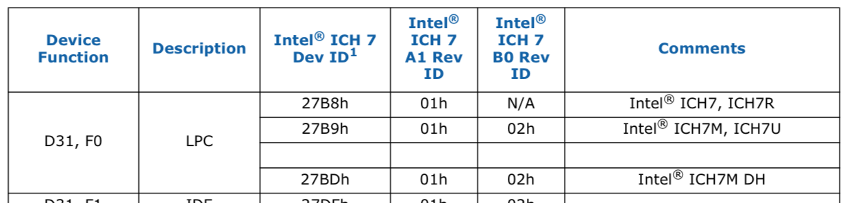
ICH/io-controller-hub-7-datasheet.pdf

Slide 51
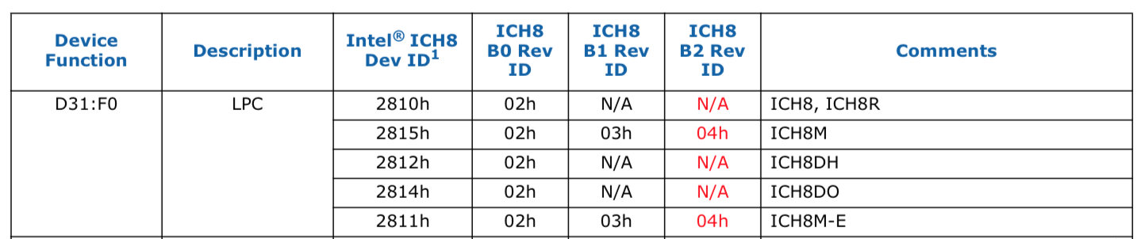
ICH/io-controller-hub-8-datasheet.pdf

Slide 52
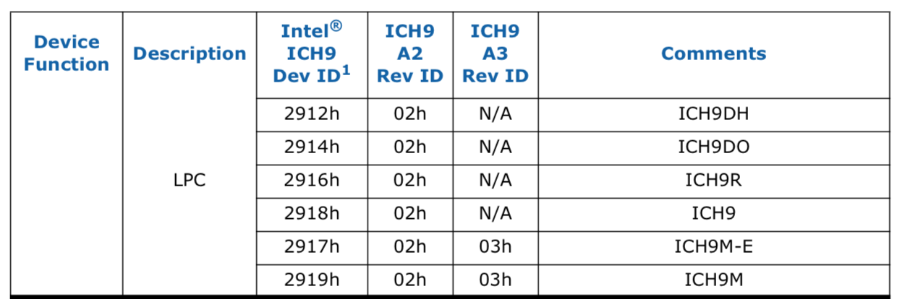
ICH/io-controller-hub-9-datasheet.pdf

Slide 53
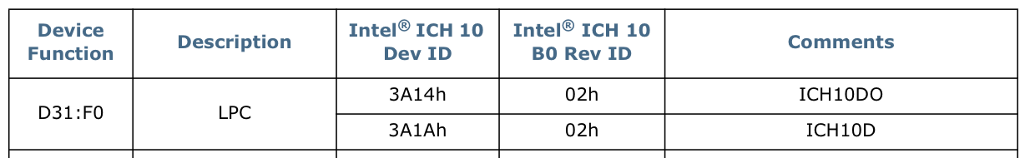
ICH/io-controller-hub-10-datasheet.pdf

Slide 54
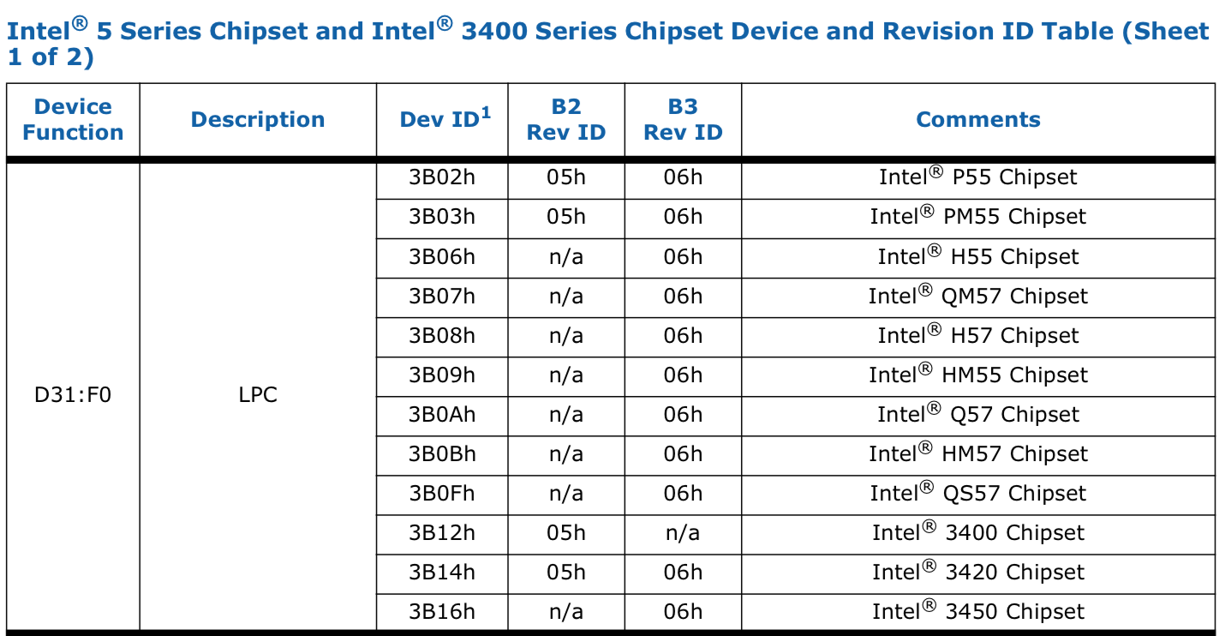
PCH/5-series-chipset-3400-chipset-datasheet.pdf

Slide 55
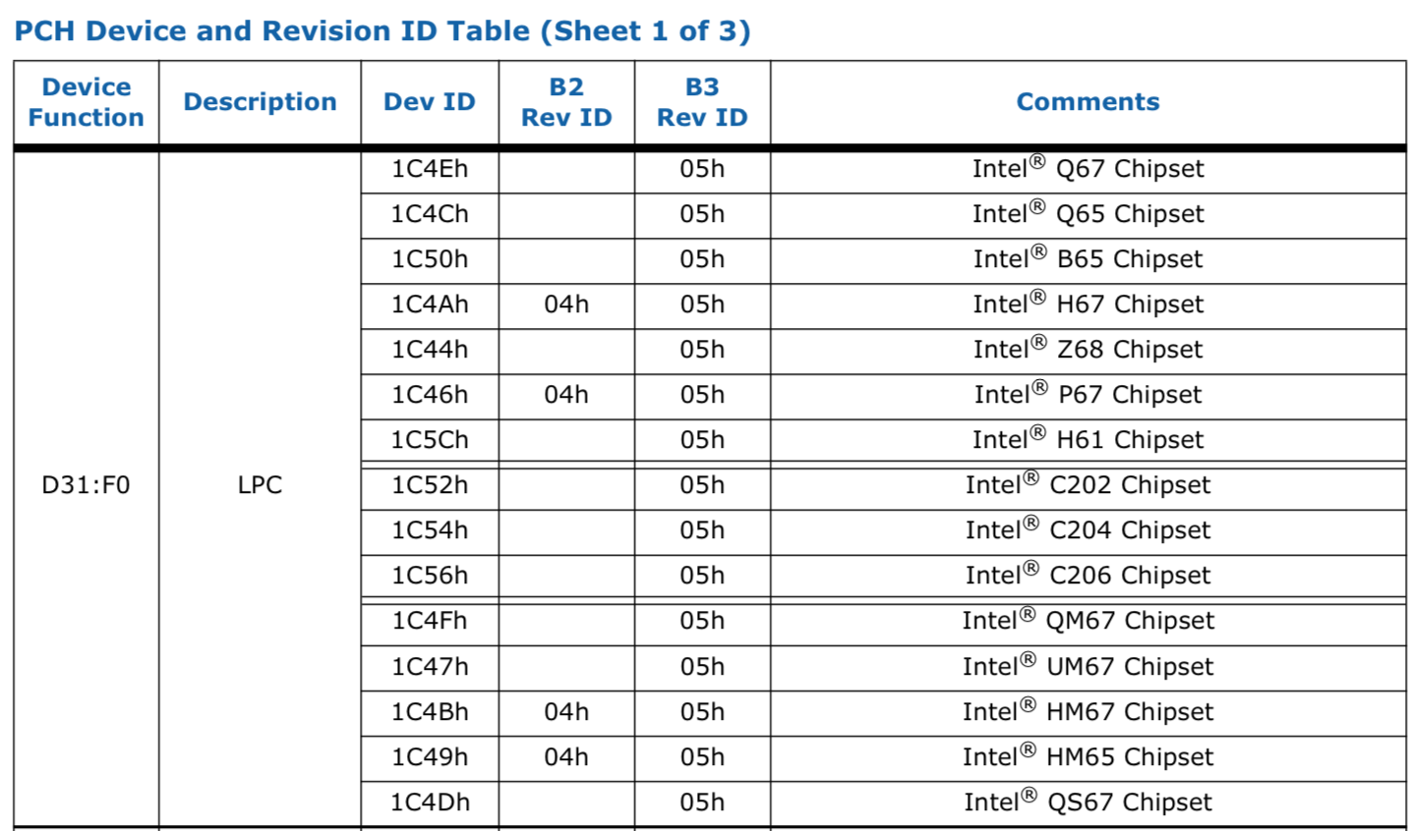
PCH/6-series-chipset-c200-chipset-datasheet.pdf

Slide 56
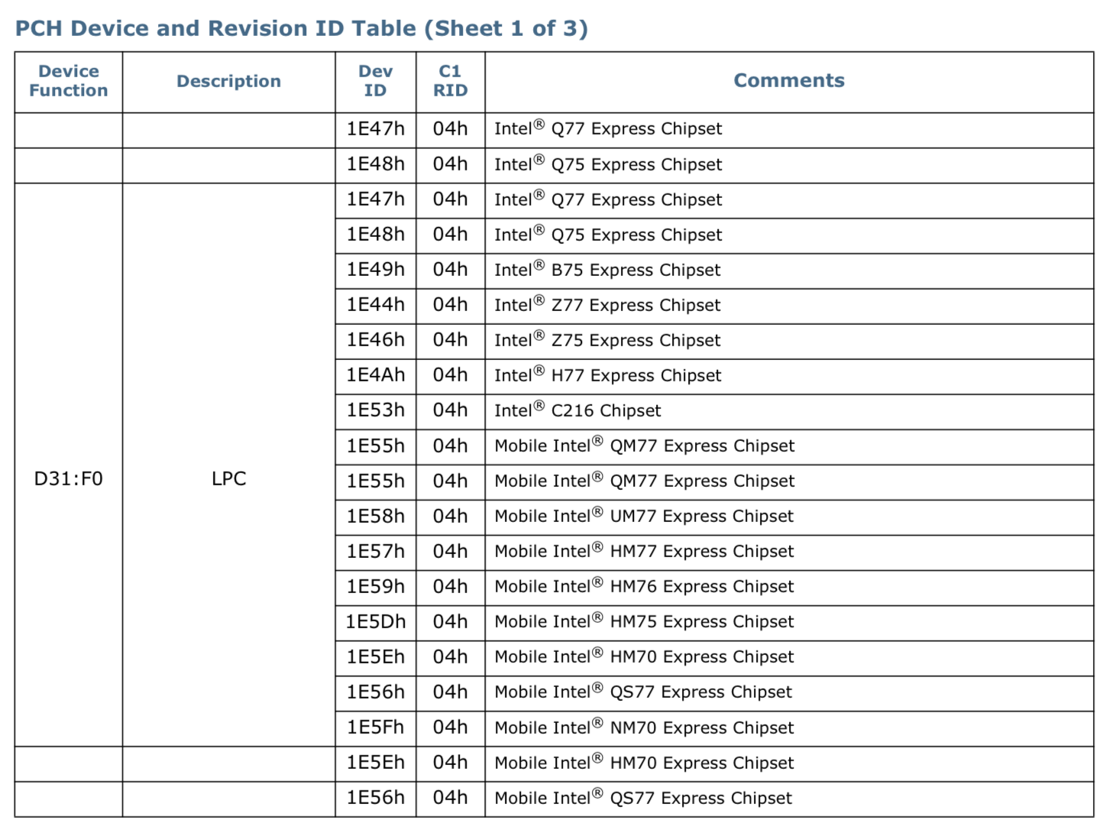
PCH/7-series-chipset-pch-datasheet.pdf

Slide 57
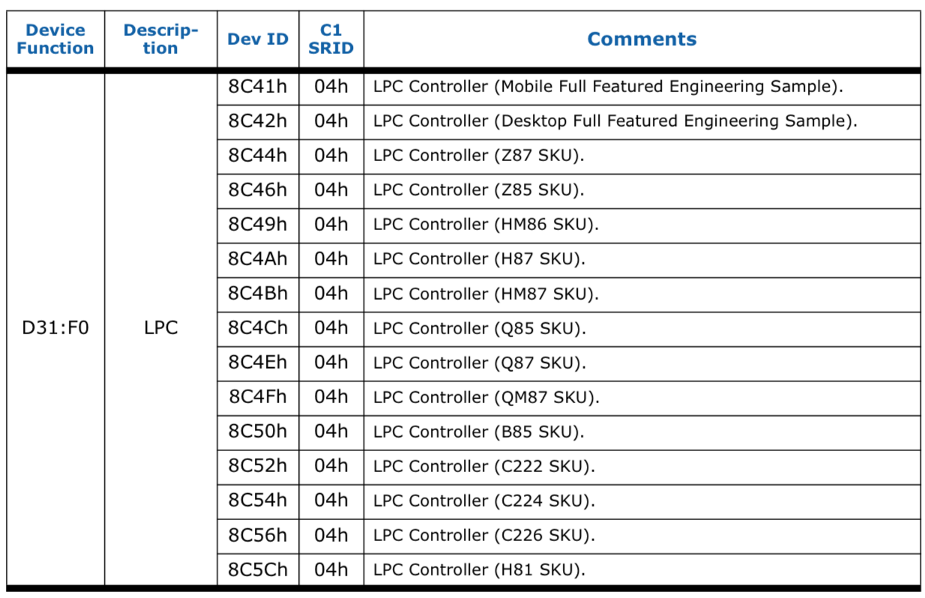
PCH/8-series-chipset-pch-datasheet.pdf
Notes:
TODO: find public 0x9C43 type device ID screen shots

Slide 58
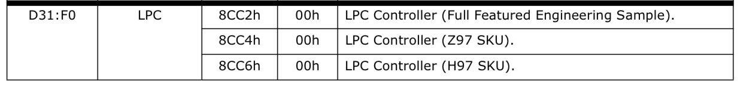
PCH/9-series-chipset-pch-datasheet.pdf

Slide 59
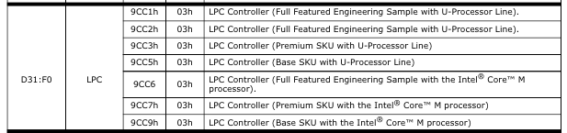
CPU/5thGen(Broadwell)/5th-gen-core-family-platform-i-o-datasheet.pdf

Slide 60
Backup

Slide 61
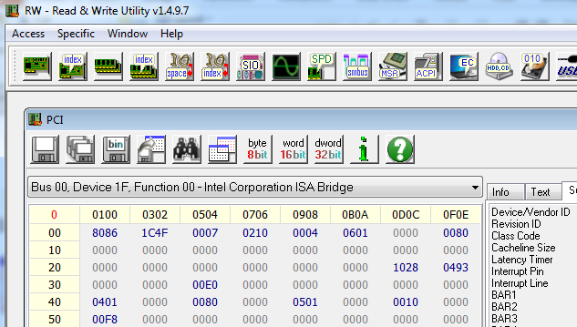
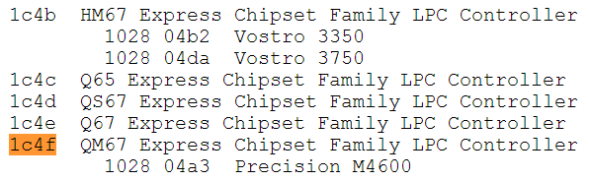
Solving Ambiguity: Get LPC Device
As before, Read the 2-byte Device ID of the LPC device:
Bus 0, Device 31d (1Fh), Function 0, Offset 2
If the Controller Hub is referred to as the Chipset, it’s a PCH device.
So in a PCH system, the LPC controller will tell us the chipset family
So this is a QM67 Express Chipset (6-series chipset)
Datasheet: http://www.intel.com/content/www/us/en/chipsets/6-chipset-c200-chipset-datasheet.html
Notes:
Sort of like a lab

Slide 62
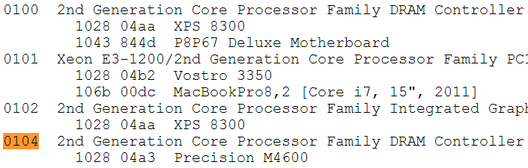
Identify the MCH Device ID
As before, Read the 2-byte Device ID of the MCH (DRAM Controller):
Bus 0, Device 0, Function 0, Offset 2
In this sample case the Memory Controller Device ID is 0x0104
2nd Generation Core processor Family
However there are separate datasheets for the 2nd generation Mobile and Desktop family datasheets
To identify the CPU, we have to download the Specification updates for each
Notes:
Sort of like a lab

Slide 63
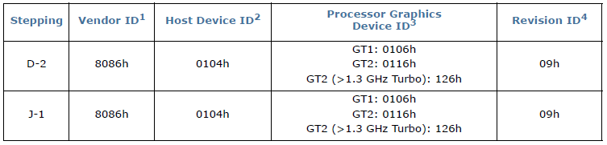
Hmm…Either Mobile or Desktop* CPU
Download the Specification Updates for both the Desktop and Mobile family (2nd generation Core series processor)
http://www.intel.com/content/dam/www/public/us/en/documents/specification-updates/2nd-gen-core-family-mobile-specification-update.pdf
http://www.intel.com/content/dam/www/public/us/en/documents/specification-updates/2nd-gen-core-desktop-specification-update.pdf
In this case, the DRAM Controller (MCH) device ID of 0104h is defined in the Mobile series specification update
*We’re operating under the assumption that this is being done remotely so we can’t just “look.”
Notes:
Sort of like a lab

Slide 64
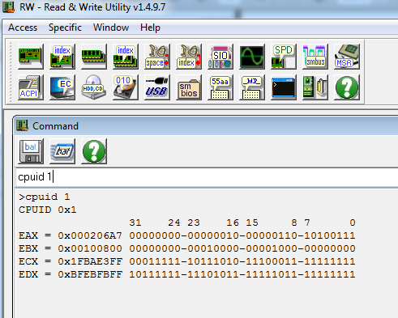
Get the CPU Stepping Information
When EAX initialized with a value of ‘1’, CPUID returns the Extended Family, Extended Model, Processor Type, Family Code, Model Number and Stepping ID value (in EAX)
You can run CPUID in RW Everything
CPUID requires no privileges to run
Notes:
Sort of like a lab

Slide 65


Identify the CPU Stepping Information
Gen2 Core Specification Update Datasheet
Extended family tells you which processor family the CPU is of (Pentium, Pentium Pro, Intel Core, etc.)
Extended Model identifies the particular model within the family
Processor Type tells you if it’s OEM, etc.
Family Code corresponds to EDX bits [11:8] at system reset
The Model Number corresponds to EDX bits [7:4] at system reset
This is a PCH example and so this CPUID return will differ from our EDX value from the entry vector portion of the course which was of the E6400
Stepping ID is the revision number of this CPU model
Notes:
Sort of like a lab

